Slide 1

Arabic QA DistilBERT Fine-Tuning
Made by: Mohamed Abdelgaber
Mahmoud Nabil
Ali Helmy
Supervisor: Dr. Mervat Mostafa Fahmy Abuelkheir
Faculty of Media Engineering and Technology (MET)

Slide 2
Contents:
Overview
Dataset
Data Preprocessing & Analysis
Model Architecture
Fine-Tuning
Results
References

Slide 3
1. Overview
Motivation:
Develop a QA model that can accurately and
efficiently answer questions in Arabic language
Growing demand for Arabic NLP applications in various fields
Challenge:
Arabic ⇾ complex language
Not enough data

Slide 4

2. Dataset
17911 QA
SQuAD (Stanford Question Answering Dataset)[2]
Arabic Questions and Answers Dataset (AQAD)[1]
3. Data Preprocessing & Analysis
Dataset
80%
20%
Train
Test

Slide 5
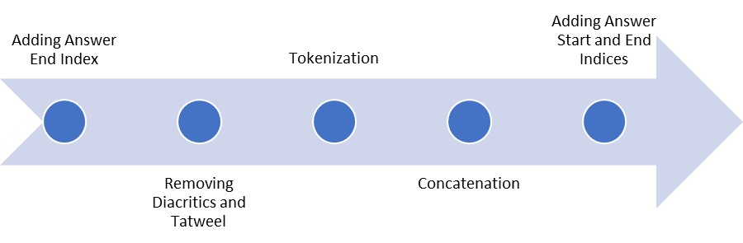
3. Data Preprocessing & Analysis
Data Preprocessing
pipeline:
Fine-tuning

Slide 6
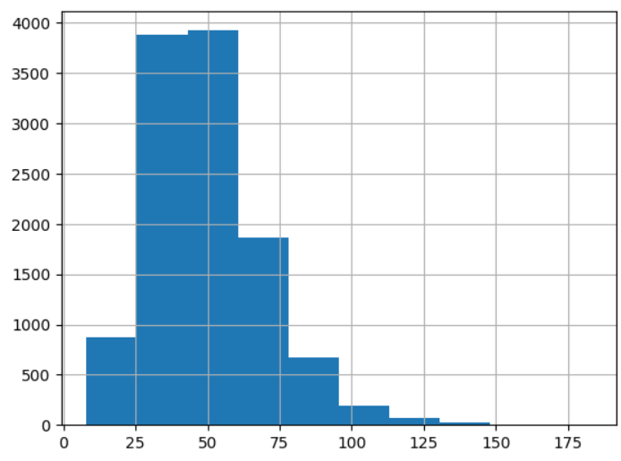
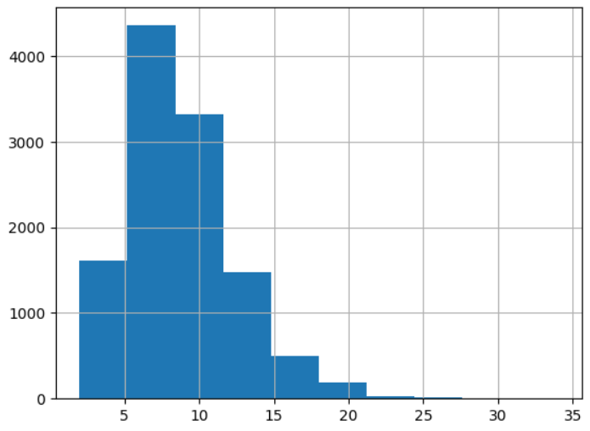
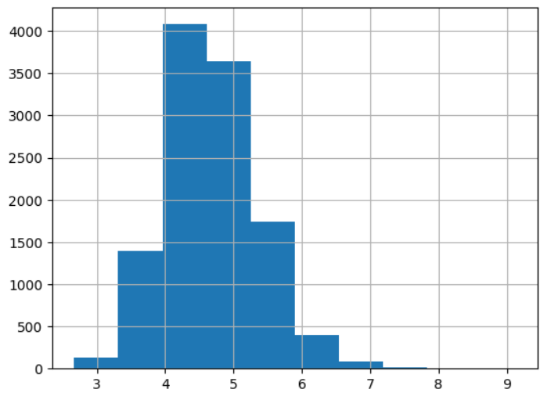
3. Data Preprocessing & Analysis
questions length
number of words per question
word length in each question

Slide 7
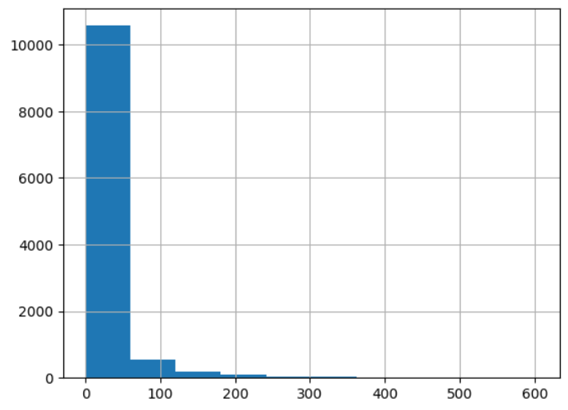
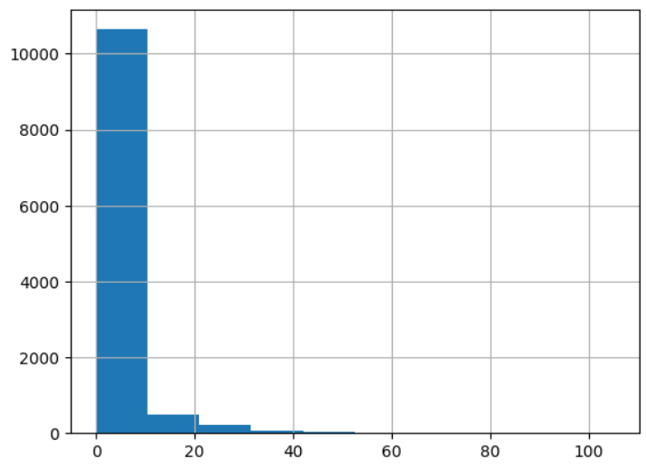
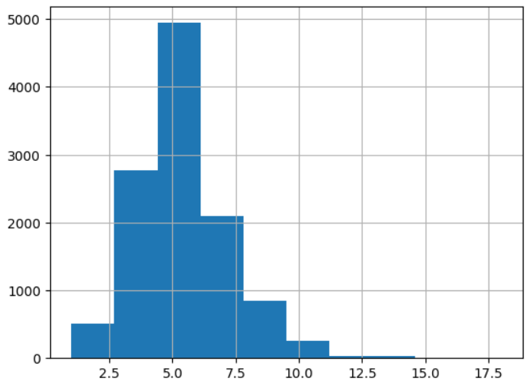
3. Data Preprocessing & Analysis
answers length
number of words per answer
word length in each answer

Slide 8
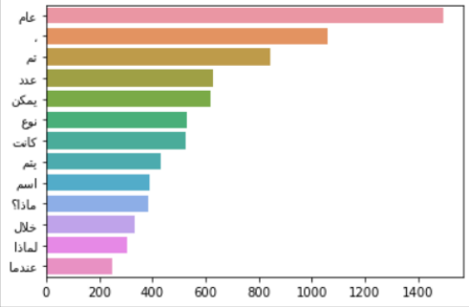
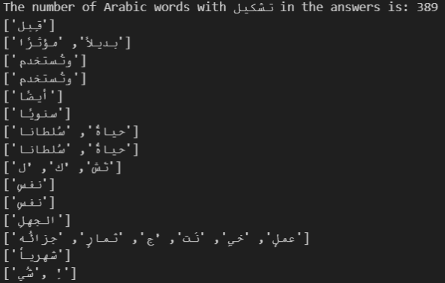
3. Data Preprocessing & Analysis

Slide 9
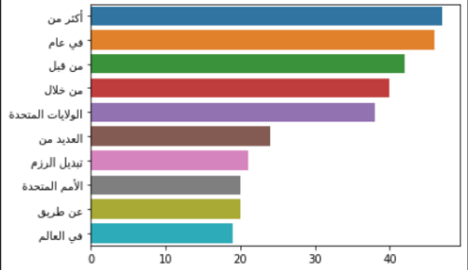
3. Data Preprocessing & Analysis

Slide 10
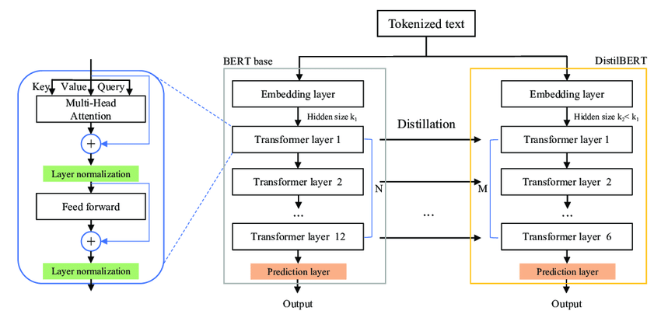
4. Model Architecture

Slide 11
5.Fine-Tuning Not Training?

Slide 12
5. Fine-Tuning
Question
+
Context
+
pre processing
+
tokenization
Distilbert model
answer start
+
answer end
|Our model expects - > context and question pair -> produce the answer.

Slide 13
5. Fine-Tuning
DistilBert multilingual cased variant model Fine-Tuning related Hyperparameters
Batch Size: 16
Epochs: 6
Optimizer: AdamW

Slide 14
DistilBertForQuestionAnswering(
(distilbert): DistilBertModel(
(embeddings): Embeddings(
(word_embeddings): Embedding(119547, 768, padding_idx=0)
(position_embeddings): Embedding(512, 768)
(LayerNorm): LayerNorm((768,), eps=1e-12, elementwise_affine=True)
(dropout): Dropout(p=0.1, inplace=False)
)
(transformer): Transformer(
(layer): ModuleList(
(0-5): 6 x TransformerBlock(
(attention): MultiHeadSelfAttention(
(dropout): Dropout(p=0.1, inplace=False)
(q_lin): Linear(in_features=768, out_features=768, bias=True)
(k_lin): Linear(in_features=768, out_features=768, bias=True)
(v_lin): Linear(in_features=768, out_features=768, bias=True)
(out_lin): Linear(in_features=768, out_features=768, bias=True)
)
(sa_layer_norm): LayerNorm((768,), eps=1e-12, elementwise_affine=True)
(ffn): FFN(
(dropout): Dropout(p=0.1, inplace=False)
(lin1): Linear(in_features=768, out_features=3072, bias=True)
(lin2): Linear(in_features=3072, out_features=768, bias=True)
(activation): GELUActivation()
)
(output_layer_norm): LayerNorm((768,), eps=1e-12, elementwise_affine=True)
)
)
)
)
(qa_outputs): Linear(in_features=768, out_features=2, bias=True)
(dropout): Dropout(p=0.1, inplace=False)
)

Slide 15
5. Fine-Tuning
setup proc_dev GPU/CPU
model loaded on detected device
model set to train mode
initialize AdamW optimizer with weight decay (reduces chance of overfitting)
initialize data loader for training data

Slide 16
5. Fine-Tuning
6. inputs in batches to tensors
7. model inputs to train with:
input_ids: The input token IDs for each example in the batch.
attention_mask: Which tokens to take ,same shape as input_ids.
start_positions: The start position of the answer span for each example in the batch.
end_positions: The end position of the answer span for each example in the batch.
Notes:
Similar to start_positions, it is used during training for calculating the loss and updating the model's parameters.

Slide 17
5. Fine-Tuning
8. calculate loss for every parameter that needs grad update
9. update parameters
10. print relevant info to progress bar
11. switch model to evaluation mode
12. loop through batches again
Notes:
Similar to start_positions, it is used during training for calculating the loss and updating the model's parameters.

Slide 18
5. Fine-Tuning
13. we don't need to calculate gradients as we're not training ,pull batched items from loader
14. make predictions
15. pull predictions out (start & end)
16. calculate accuracy for both & avg acc
Notes:
Similar to start_positions, it is used during training for calculating the loss and updating the model's parameters.

Slide 19
6. Results

Slide 20
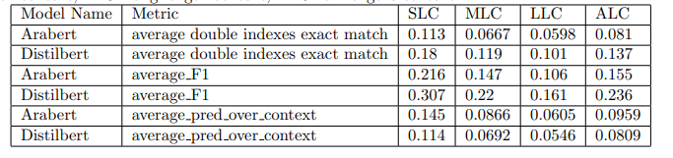
6. Results
Table 1 presents metrics for different tokinzers evaluated on datasets with varying context lengths.
Notes:
Similar to start_positions, it is used during training for calculating the loss and updating the model's parameters.

Slide 21
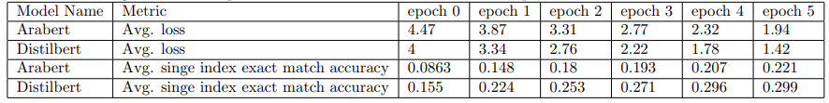
6. Results
Table 2 provides a comparison of two tokinzers, Arabert and Distilbert, based on different metrics at various epochs.
Notes:
Similar to start_positions, it is used during training for calculating the loss and updating the model's parameters.

Slide 22

6. Results
Table 3 displays key details regarding different context lengths.
Notes:
Similar to start_positions, it is used during training for calculating the loss and updating the model's parameters.

Slide 23

6. Results Summary, Conclusion
Table 1 -> shorter contexts -> yield better results.
3 Tables -> topics that were more extensively represented in the training data should demonstrate better results.
DistilBERT multilingual tokenizer
Arabert tokenizer
Average Loss
F1 score
exact match accuracy
double-index exact match metrics

Slide 24
7. References
[1] Imane Guellil, Houda Saˆadane, Faical Azouaou, Billel Gueni, and Damien Nouvel. Arabic
natural language processing: An overview. Journal of King Saud University - Computer
and Information Sciences, 33(5):497–507, jun 2021.
[2] Stanford Question Answering Dataset (SQuAD),https://paperswithcode.com/dataset/squad
[3] DistilBERT, a distilled version of BERT: smaller, faster, cheaper and lighter,Victor Sanh and Lysandre Debut and Julien Chaumond and Thomas Wolf,2020,1910.01108

Slide 25
Thank You
Questions?

